Slide 1
Disk Representations: Files, Pages, Records
Prof. Joseph Hellerstein

Slide 2
Storing Data: Files

Slide 3
FILE REPRESENTATIONS

Slide 4
Overview: Representations
Record
SSN | Last Name | First Name | Age | Salary
123 | Adams | Elmo | 31 | $400
443 | Grouch | Oscar | 32 | $300
244 | Oz | Bert | 55 | $140
134 | Sanders | Ernie | 55 | $400
Bob
Harmon
M
32
400
Varchar
Varchar
Char
Int
Int
Byte Representation of Record
File
Header
M
Bob
Harmon
94703
32
Page 1
Page 2
Slotted Page
Page Header
Page 3
Page 4
Page 5
Page 6

Slide 5
Overview: Files of Pages of Records
Tables stored as logical files
Consist of pages
Pages contain a collection of records
Pages are managed
On disk by the disk space manager: pages read/written to physical disk/files
In memory by the buffer manager: higher levels of DBMS only operate in memory
Page Header
Page Header
Page Header
Page Header
Page Header
Page Header

Slide 6
Database Files

Slide 7
Files of Pages of Records
DB FILE: A collection of pages, each containing a collection of records.
API for higher layers of the DBMS:
Insert/delete/modify record
Fetch a particular record by record id …
Record id is a pointer encoding pair of (pageID, location on page)
Scan all records
Possibly with some conditions on the records to be retrieved
Could span multiple OS files and even machines
Or “raw” disk devices

Slide 8
Many DB File Structures
Unordered Heap Files
Records placed arbitrarily across pages
Clustered Heap Files
Records and pages are grouped
Sorted Files
Pages and records are in sorted order
Index Files
B+ Trees, Linear Hashing, …
May contain records or point to records in other files

Slide 9
Unordered Heap Files
Collection of records in no particular order
Not to be confused with “heap” data-structure
As file shrinks/grows, pages (de)allocated
To support record level operations, we must
Keep track of the pages in a file
Keep track of free space on pages
Keep track of the records on a page

Slide 10
Heap File Implemented as List
Header page ID and Heap file name stored elsewhere
Database catalog
Each page contains 2 “pointers” plus free space and data
What is wrong with this?
How do I find a page with enough space for a 20 byte records
Data
Page
Data
Page
Data
Page
Full Pages
Header
Page
Data
Page
Data
Page
Data
Page
Pages with
Free Space

Slide 11
Better: Use a Page Directory
Header Page
Directory entries include:
#free bytes on the referenced page
Header pages accessed often → likely in cache
Finding a page to fit a record required far fewer page loads than linked list
Why?
One header page load reveals free space of many pages
You can imagine optimizing the page directory further
But diminishing returns?
Data
Page 1
Data
Page 2
Data
Page N
DIRECTORY

Slide 12
Summary
Table encoded as files which are collections of pages
File
Page 1
Page 2
SSNz | Last Name | First Name | Age | Salary
123 | Adams | Elmo | 31 | $400
443 | Grouch | Oscar | 32 | $300
244 | Oz | Bert | 55 | $140
134 | Sanders | Ernie | 55 | $400
Page 3
Page 4
Page 5
Page 6

Slide 13
Page Layout

Slide 14
Page Basics: The Header
Page Header
Header may contain:
Number of records
Free space
Maybe a next/last pointer
Bitmaps, Slot Table

Slide 15
Things to Address
Page Header
Record length? Fixed or Variable
Find records by record id?
Record id = (Page, Location in Page)
How do we add and delete records?

Slide 16
Options for Page Layouts
Depends on
Record length (fixed or variable)
Page packing (packed or unpacked)

Slide 17
Indexes: Sneak Preview
A Heap file allows us to retrieve records:
By specifying the record id (page id + offset)
By scanning all records sequentially
Would like to fetch records by value, e.g.,
Find all students in the “CS” department
Find all students with a “GPA” > 3 AND “blue hair”
Indexes: file structures for efficient value-based queries

Slide 18
Content Break

Slide 19
A Note On Imagery
Data is stored in linear order
1 byte per position
Memory addresses are ordered
Disk addresses are ordered
This doesn’t fit nicely on screen
So we will “wrap around” the linear order into a rectangle

Slide 20
Fixed Length Records, Packed
Pack records densely
Record id = (pageId, “location in page”)?
(pageId, record number in page)!
We know the offset from start of page!
Easy to add: just append
Delete?
Page Header
Record
Record
Record
Record
Record
Record

Slide 21
Fixed Length Records, Packed, Pt 2.
Record id:
(Page 2, Record 4)
Pack records densely
Record id = (pageId, “location in page”)?
(pageId, record number in page)!
We know the offset from start of page!
Easy to add: just append
Delete?
Page Header
Record
Record
Record
Record
Record
Record

Slide 22
Fixed Length Records: Packed, Pt 3.
Record id:
(Page 2, Record 4)
Pack records densely
Record id = (pageId, “location in page”)?
(pageId, record number in page)!
We know the offset from start of page!
Easy to add: just append
Delete?
Page Header
Record
Record
Record
Record
Record

Slide 23
Fixed Length Records: Packed, Pt. 5
Record id:
(Page 2, Record 3)
Pack records densely
Record id = (pageId, “location in page”)?
(pageId, record number in page)!
We know the offset from start of page!
Easy to add: just append
Delete?
Packed implies re-arrange!
Record Id pointers need to be updated!
Could be expensive if they’re in other files.
Page Header
Record
Record
Record
Record
Record

Slide 24
Fixed Length Records: Unpacked
Record id:
(Page 2, Record 4)
Bitmap
Page Header
Record
Record
Bitmap denotes “slots” with records
Record id: record number in page
Insert: find first empty slot
Delete: Clear bit
Record
Record
Record
Record
Record

Slide 25
Fixed Length Records: Unpacked, Pt. 2
Record id:
(Page 2, Record 4)
Bitmap
Page Header
Record
Record
Bitmap denotes “slots” with records
Record id: record number in page
Insert: find first empty slot
Delete: Clear bit
Record
Record
Record
Record
Record

Slide 26
Content Break 2

Slide 27
Variable Length Records
How do we know where each record begins?
What happens when we add and delete records?
Record id:
(Page 2, Record 4)
Page Header
Record
Record
Record
Record
Record
Record

Slide 28
First: Relocate metadata to footer
We’ll see why this is handy shortly…
Record
Record
Record
Record
Record
Footer

Slide 29
Slotted Page
Introduce slot directory in footer
Pointer to free space
Length + Pointer to beginning of record
reverse order
Record ID = location in slot table
from right
Delete?
e.g., 4th record on the page
Record
Record
Record
Record
Record
Footer
18
12
32
24
16
Slot Directory
Record Id:
(Page 2, Record 4)

Slide 30
Slotted Page: Delete Record
Delete record (Page 2, Record 4): Set 4th slot directory pointer to null
Doesn’t affect pointers to other records
Record
Record
Record
Record
Record
Footer
18
32
24
16
Slot Directory
Record Id:
(Page 2, Record 4)

Slide 31
Slotted Page: Insert Record
Insert:
Record
Record
Record
Record
Record
Footer
18
32
24
16
Slot Directory
Record Id:
(Page 2, Record 4)

Slide 32
Slotted Page: Insert Record, Pt 2.
Insert:
Place record in free space on page
Record
Record
Record
Record
Record
Record
Footer
18
32
24
16
Slot Directory
Record Id:
(Page 2, Record 4)

Slide 33
Slotted Page: Insert Record, Pt. 3
Insert:
Place record in free space on page
Create pointer/length pair in next open
slot in slot directory
Record
Record
Record
Record
Record
Record
Footer
18
42
32
24
16
Slot Directory
Record Id:
(Page 2, Record 4)

Slide 34
Slotted Page: Insert Record, Pt. 4
Insert:
Place record in free space on page
Create pointer/length pair in next open
slot in slot directory
Update the free space pointer
Record
Record
Record
Record
Record
Record
Footer
18
42
32
24
16
Slot Directory
Record Id:
(Page 2, Record 4)

Slide 35
Slotted Page: Insert Record, Pt. 5
Insert:
Place record in free space on page
Create pointer/length pair in next open
slot in slot directory
Update the free space pointer
Fragmentation?
Record
Record
Record
Record
Record
Record
Footer
18
42
32
24
16
Slot Directory
Record Id:
(Page 2, Record 4)

Slide 36
Slotted Page: Insert Record, Pt. 6
Insert:
Place record in free space on page
Create pointer/length pair in next open
slot in slot directory
Update the free space pointer
Fragmentation?
Reorganize data on page!
Record
Record
Record
Record
Record
Footer
18
42
32
24
16
Slot Directory
Record Id:
(Page 2, Record 4)

Slide 37
Slotted Page: Leading Questions
Reorganize data on page
Is this safe?
Yes this is safe because records ids
don’t change.
When should I reorganize?
We could re-organize on delete
Or wait until fragmentation blocks
record addition and then reorganize.
Often pays to be a little sloppy if page
never gets more records.
What if we need more slots?
Let’s see…
Record
Record
Record
Record
Record
Footer
18
42
32
24
16
Slot Directory
Record Id:
(Page 2, Record 4)

Slide 38
Slotted Page: Growing Slots
Tracking number of slots in slot directory
Empty or full
Record
Record
Record
Record
Record
Footer
18
42
32
24
16
5
Slot Directory
Record Id:
(Page 2, Record 4)

Slide 39
Slotted Page: Growing Slots, Pt. 2
Tracking number of slots in slot directory
Empty or full
Extend slot directory
Slots grow from end of page inward
Records grow from beginning of page inward.
Easy!
Record
Record
Record
Record
Record
Record
Footer
16
18
42
32
24
16
5
Slot Directory
Record Id:
(Page 2, Record 4)

Slide 40
Slotted Page: Growing Slots, Pt. 3
Tracking number of slots in slot directory
Empty or full
Extend slot directory
Slots grow from end of page inward
Records grow from beginning of page inward.
Easy!
And update count
Record
Record
Record
Record
Record
Record
Footer
16
18
42
32
24
16
6
Slot Directory
Record Id:
(Page 2, Record 4)

Slide 41
Slotted Page: Summary
Record
Record
Record
Record
Typically use Slotted Page
Good for variable and fixed length records
Not bad for fixed length records too.
Why?
Re-arrange (e.g., sort) and squash null fields
But for a whole table of fixed-length non-null records, can be worth the optimization of fixed-length format
Record
Record
Footer
16
18
42
32
24
16
6
Slot Directory

Slide 42
Record LAYOUT
Record Formats

Slide 43
Record Formats
Relational Model →
Each record in table has some fixed type
Assume System Catalog stores the Schema
No need to store type information with records (save space!)
Catalog is just another table …
Goals:
Records should be compact in memory & disk format
Fast access to fields (why?)
Easy Case: Fixed Length Fields
Interesting Case: Variable Length Fields

Slide 44
Record Formats: Fixed Length
Field types same for all records in a file.
Type info stored separately in system catalog
On disk byte representation same as in memory
Finding i’th field?
done via arithmetic (fast)
Compact? (Nulls?)
24
4
8
1
4
7
3
3.142
T
3
HELLO_W
INTEGER
DOUBLE
INTEGER
CHARACTER(7)
BOOLEAN

Slide 45
Record Formats: Variable Length
What happens if fields are variable length?
Could store with padding? (Fixed Length)
Record
Bob
Big, St.
M
32
94703
VARCHAR
VARCHAR
CHAR
INT
INT
Wasted Space
Bob
Big, St.
M
32
94703
CHAR(20)
CHAR(18)
CHAR
INT
INT
Field Not Big Enough
Alice
M
32
94703
Boulevard of the Allies
CHAR(20)
CHAR(18)
CHAR
INT
INT

Slide 46
Record Formats: Variable Length, Pt 2.
What happens if fields are variable length?
Could use delimiters (i.e., CSV):
Issues?
Record
Bob
Big, St.
M
32
94703
VARCHAR
VARCHAR
CHAR
INT
INT
Comma Separated Values (CSV)
Bob
,
Big, St.
,
M
,
32
,
94703
VARCHAR
VARCHAR
CHAR
INT
INT

Slide 47
Record Formats: Variable Length, Pt. 3
What happens if fields are variable length?
Could use delimiters (i.e., CSV):
Requires scan to access field
What if text contains commas?
Record
Bob
Big, St.
M
32
94703
VARCHAR
VARCHAR
CHAR
INT
INT
Comma Separated Values (CSV)
Bob
,
Big, St.
,
M
,
32
,
94703
VARCHAR
VARCHAR
CHAR
INT
INT

Slide 48
Record Formats: Variable Length, Pt 5.
What happens if fields are variable length?
Store length information before fields:
Requires scan to access field
Idea: Move all variable length fields to end enable fast access
Record
Bob
Big, St.
M
32
94703
VARCHAR
VARCHAR
CHAR
INT
INT
Comma Separated Values (CSV)
Bob
,
Big, St.
,
M
,
32
,
94703
VARCHAR
VARCHAR
CHAR
INT
INT

Slide 49
Record Formats: Variable Length, Pt. 7
What happens if fields are variable length?
Introduce a record header
Direct access & no “escaping”, other advantages?
Handle null fields easily →
useful for fixed length records too!
Record
Bob
Big, St.
M
32
94703
VARCHAR
VARCHAR
INT
INT
Header
M
32
94703
Bob
Big, St.
CHAR
INT
INT
VARCHAR
VARCHAR

Slide 50
Summary 2
Record
SSN | Last Name | First Name | Age | Salary
123 | Adams | Elmo | 31 | $400
443 | Grouch | Oscar | 32 | $300
244 | Oz | Bert | 55 | $140
134 | Sanders | Ernie | 55 | $400
Bob
Harmon
M
32
400
Varchar
Varchar
Char
Int
Int
Byte Representation of Record
File
Header
M
Bob
Harmon
94703
32
Page 1
Page 2
Slotted Page
Page Header
Page 3
Page 4
Page 5
Page 6

Slide 51
Content Break 3

Slide 52
System Catalogs
For each relation:
name, file location, file structure (e.g., Heap file)
attribute name and type, for each attribute
index name, for each index
integrity constraints
For each index:
structure (e.g., B+ tree) and search key fields

Slide 53
System Catalogs Pt. 2
For each view:
view name and definition
Plus statistics, authorization, buffer pool size, etc
Catalogs are themselves stored as relation!

Slide 54
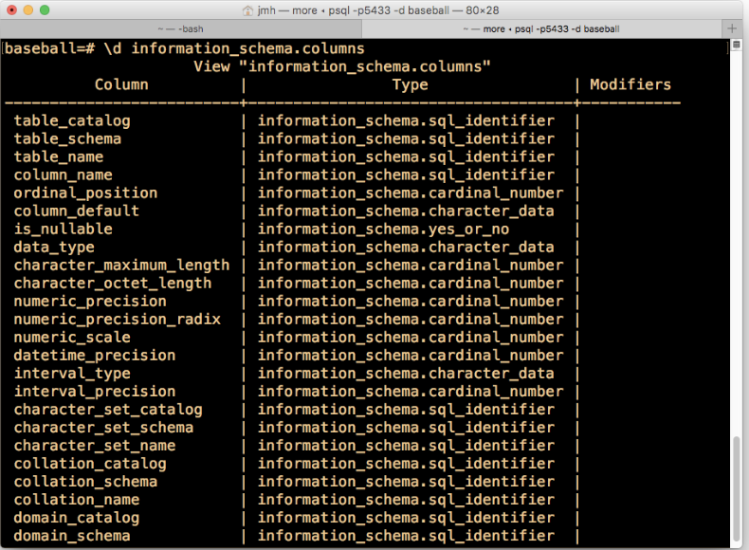
PostgreSQL Information Schema

Slide 55
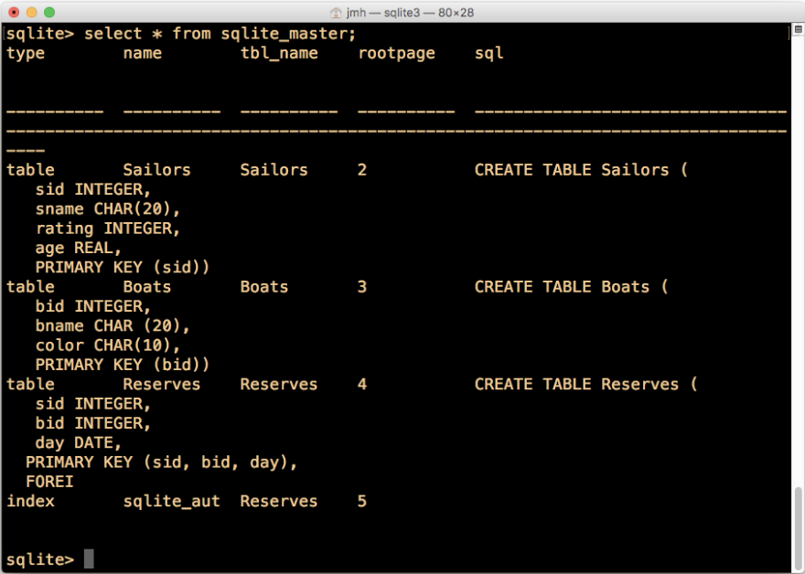
sqlite_master

Slide 56
Files: Summary
DBMS “File” contains pages, and records within pages
Heap files: unordered records organized with directories
Page layouts
Fixed-length packed and unpacked
Variable length records in slotted pages, with intra-page reorg
Variable length record format
Direct access to i’th field and null values
Catalog relations store information about relations,
indexes and views.

